Slide 1
Investigating the Impact of Feature Extraction techniques for Classification and synthesis of Dysarthric Speech
URK21CS1072 - Daniel Prem

Slide 2
Agenda :
Introduction
Problem Statement
Literature Review
System Overview
Methodology
Experimental Setup
Results

Slide 3
Introduction
Aim: Develop and evaluate a novel Hilbert Spectrum-based feature extraction method for dysarthric speech recognition, comparing its performance with traditional spectrogram and end-to-end models.
Motivation: Address the shortcomings of conventional spectrogram-based ASR systems in capturing the non-linear and dynamic articulatory variations of dysarthric speech.
Project Significance: Enhance assistive communication technologies by improving the accuracy and adaptability of ASR for individuals with speech disorders.

Slide 4
Problem Statement
Conventional spectrogram-based feature extraction methods inadequately capture the non-linear, dynamic articulatory variations in dysarthric speech, leading to suboptimal performance of ASR systems and limiting the efficacy of assistive communication tools for individuals with speech disorders.
Goal: Design a robust system to accurately recognize dysarthric speech patterns and synthesize them into clear, understandable voice output.

Slide 5
Literature Review
Existing Approaches:
Traditional features (e.g., MFCCs, spectrograms) improved with methods like DMFCC [Zhang et al.] and feature fusion [Lauraitis et al.], proving high classification accuracy.
Adaptive systems (e.g., fine-tuned Whisper) lower word error rates, effectively handling severe dysarthria.
Key Insights:
The Hilbert Spectrum adapts to non-linear, transient speech features, as shown in EEG-based recognition [Agarwal and Kumar] and depression detection [Liu et al.].
Integrating such adaptive features into end-to-end systems bridges the performance gap between ASR systems and human listeners.

Slide 6
System Overview
Project Components:
Audio Data Collection and Pre-processing
TORGO Dataset
Dysarthric Speech Detection Module
Speech Classification and Feature Extraction
Text-to-Speech (TTS) Synthesis Module
Working Process:
Real-time processing pipeline for efficient input, analysis, and output.

Slide 7
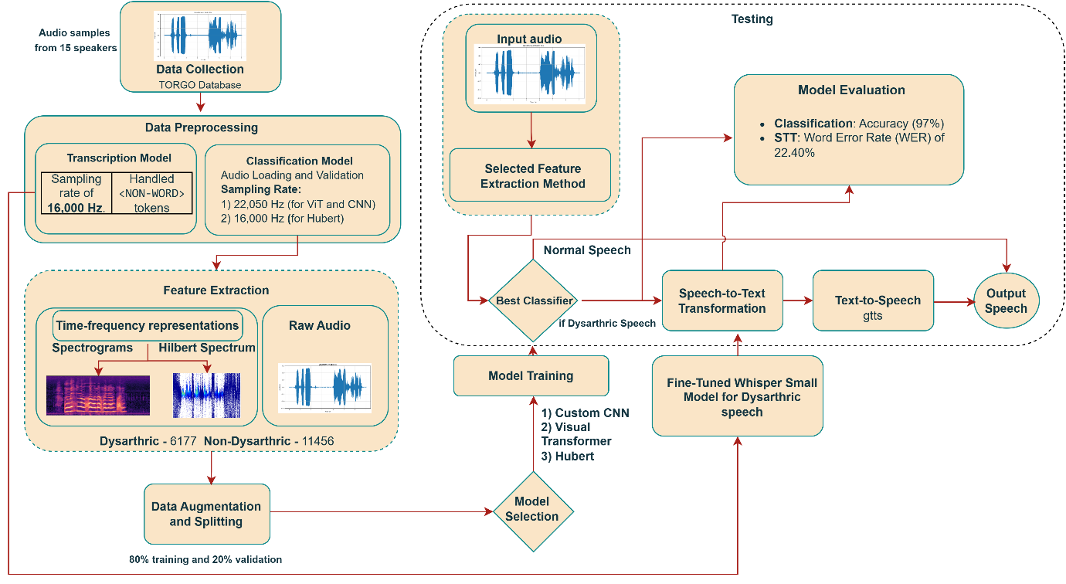
methodology

Slide 8
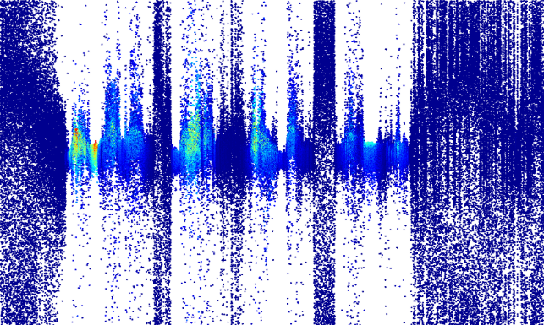
Methodology
Data Collection & Preprocessing:
Gather audio samples from the TORGOS database (dysarthric and non-dysarthric).
Perform audio loading, normalization, and segmentation.
Hilbert Spectrum Conversion:
Convert preprocessed audio to Hilbert Spectra for adaptive, instantaneous time-frequency analysis.
Model Training & Comparison
Train a custom CNN on Hilbert Spectrum features (achieved ~95% accuracy).
Compare with CNNs on traditional spectrograms (96–97%), HuBERT on raw audio (~97.27%), and ViT on spectrograms (~91%).
End-to-End System Integration
Fine-tune a Whisper small model for speech-to-text on dysarthric audio.
Use Google Text-to-Speech (gTTS) to convert transcribed text into clear, intelligible speech.
Evaluation
Assess classification accuracy and Word Error Rate (WER) for speech-to-text.
Demonstrate competitive performance of Hilbert Spectrum-based features in capturing non-stationary speech patterns.

Slide 9
Experimental Setup
Hardware:
High-performance CPU/GPU for real-time processing, microphone arrays for high-quality audio capture.
Software:
Python environment with TensorFlow or PyTorch for model training.
Text-to-Speech (TTS) libraries for voice output

Slide 10
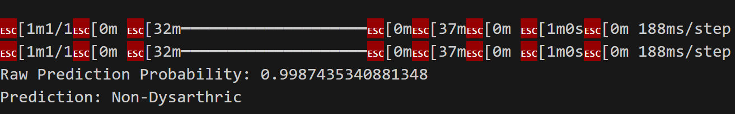
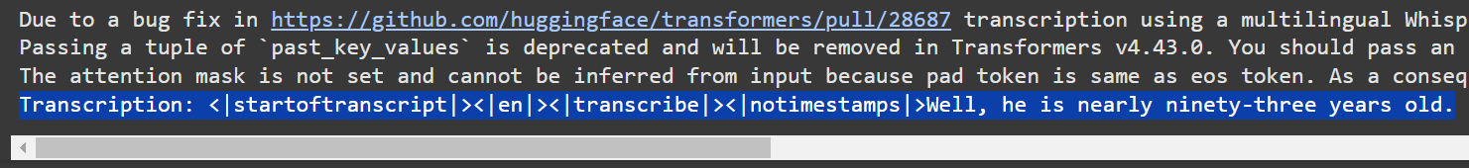
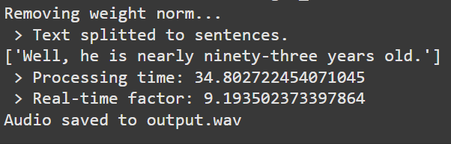
Output
For classifying Dysarthric Speech from regular speech
Synthesising audio to corrected text
Text-to-Speech

Slide 11
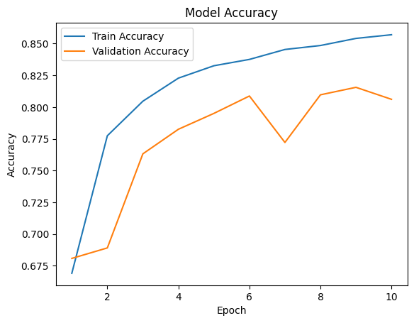
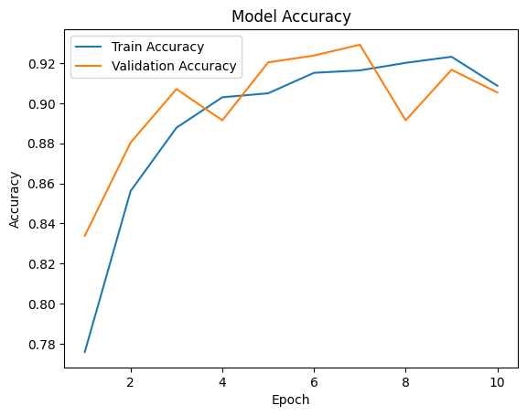
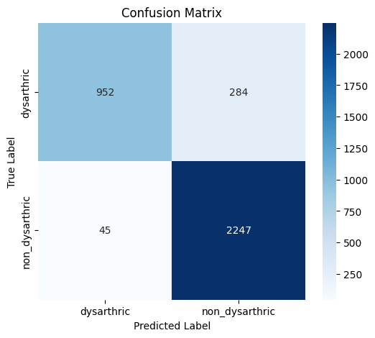
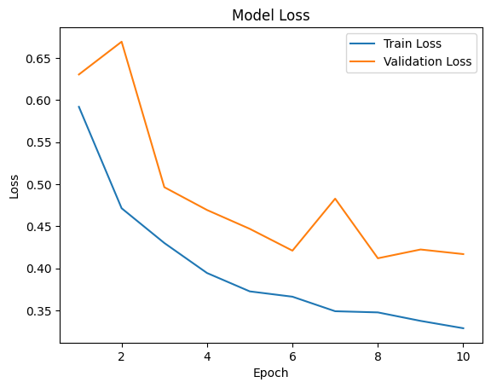
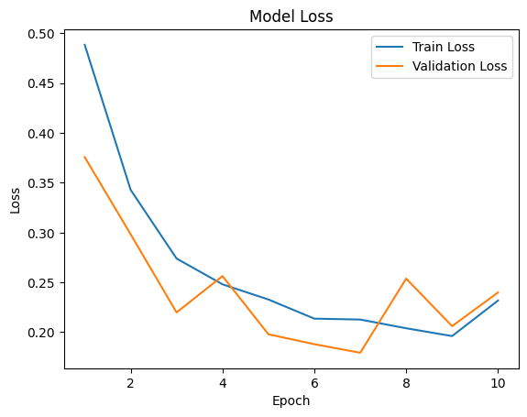
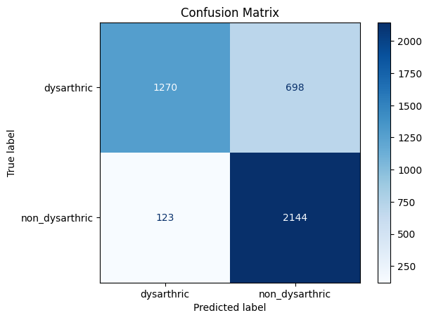
Results
ViT + Hilbert Accuracy | ViT + Spectrogram Accuracy
ViT + Hilbert Confusion Matrix
ViT + Hilbert loss | ViT + Spectrogram loss
ViT + Hilbert Confusion Matrix

Slide 12
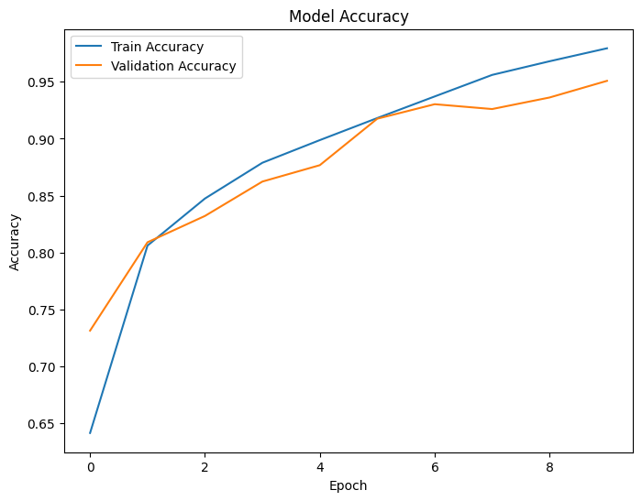
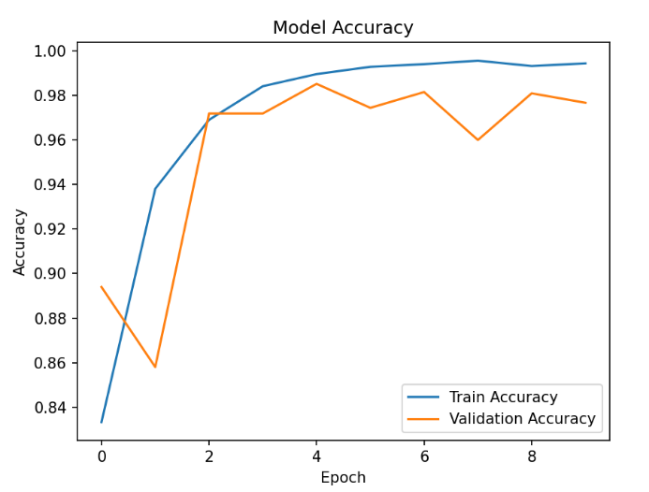
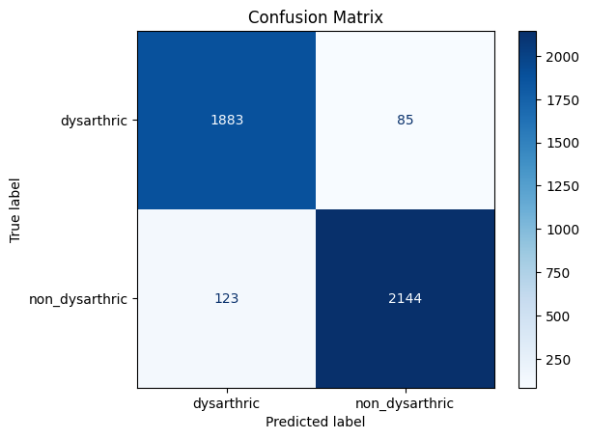
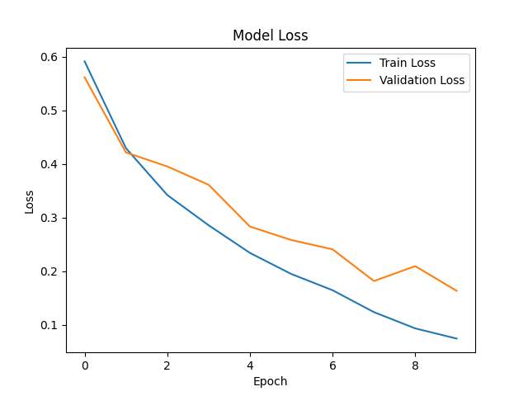
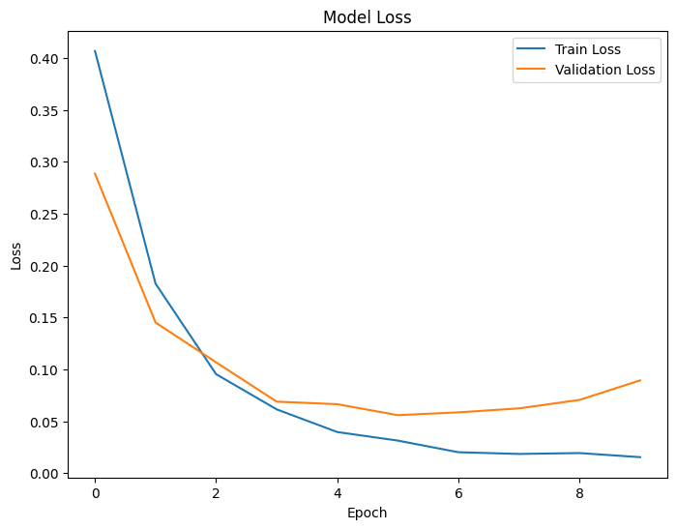
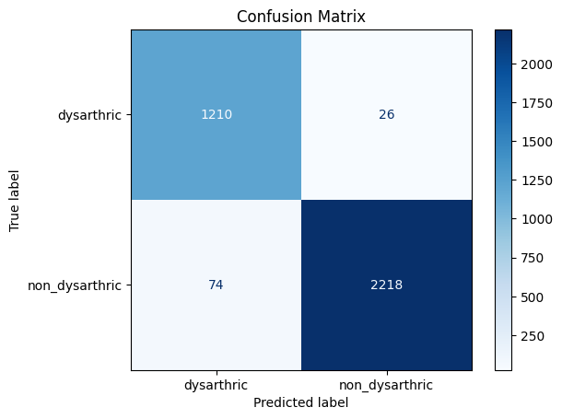
Results
CNN + Hilbert Accuracy | CNN + Spectrogram Accuracy
CNN + Hilbert Confusion Matrix
CNN + Hilbert loss | CNN + Spectrogram loss
CNN + Hilbert Confusion Matrix

Slide 13
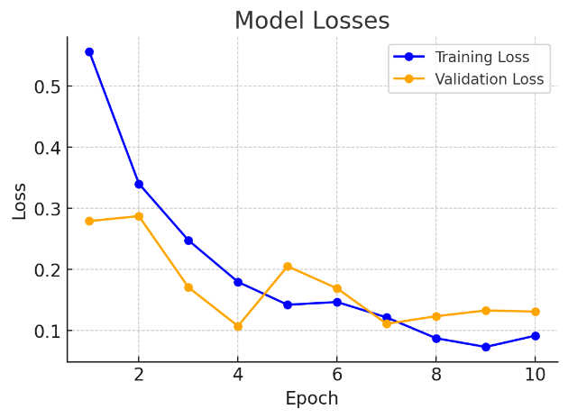
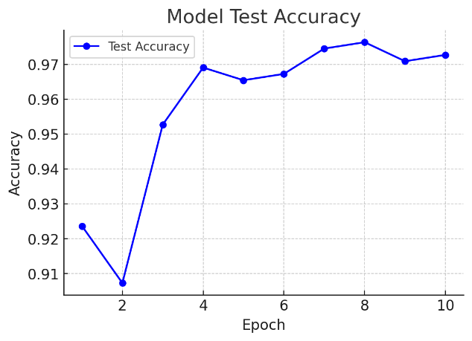
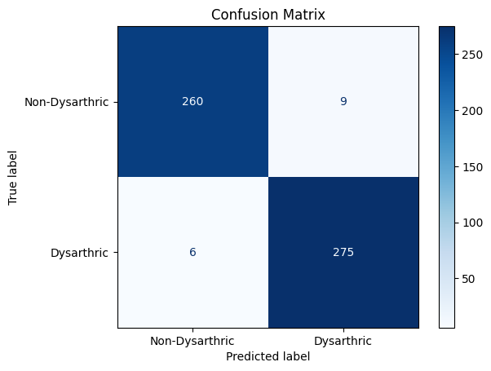
Results
HuBERT Accuracy
HuBERT loss
HUBERT Confusion Matrix

Slide 14
Conclusion and Future Work
Conclusion:
Successfully developed a multi-modal system for dysarthric speech recognition and synthesis, enhancing communication accessibility.
The system demonstrates effectiveness in processing complex speech patterns.
Future Work:
Expand the dataset to cover a wider range of dysarthric speech variations.
Explore additional synthesis customization options to personalize outputs.
Potential integration with mobile or portable devices for greater accessibility.

Slide 15
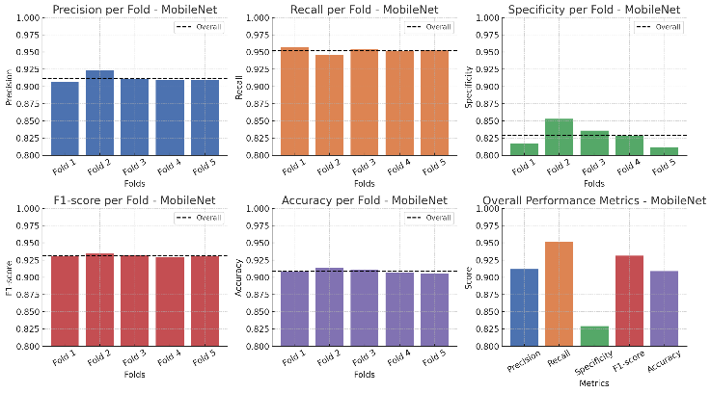
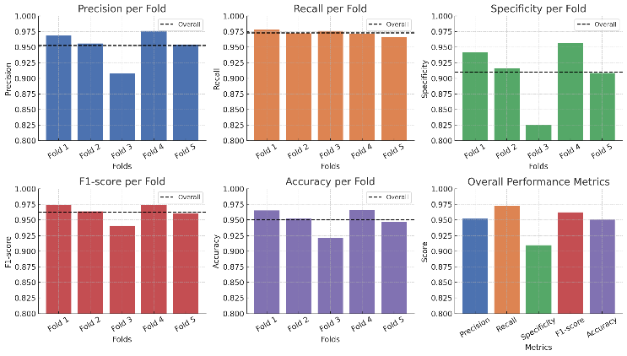
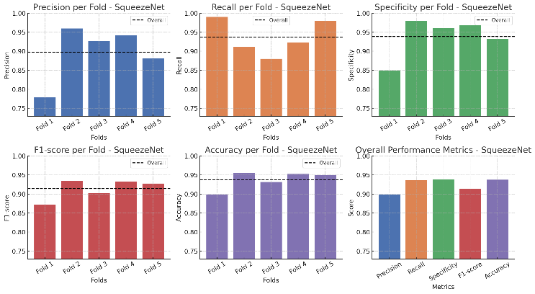
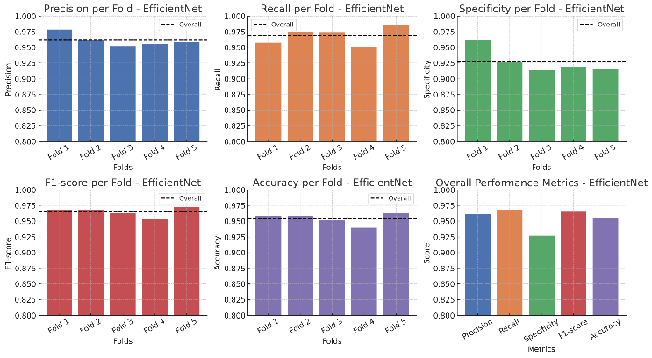
Results
per-fold and overall performance metrics for MobileNet
per-fold and overall performance metrics for ShuffleNet
per-fold and overall performance metrics for SqueezeNet
per-fold and overall performance metrics for EfficientNet

Slide 16
Thank you

